Slide 1
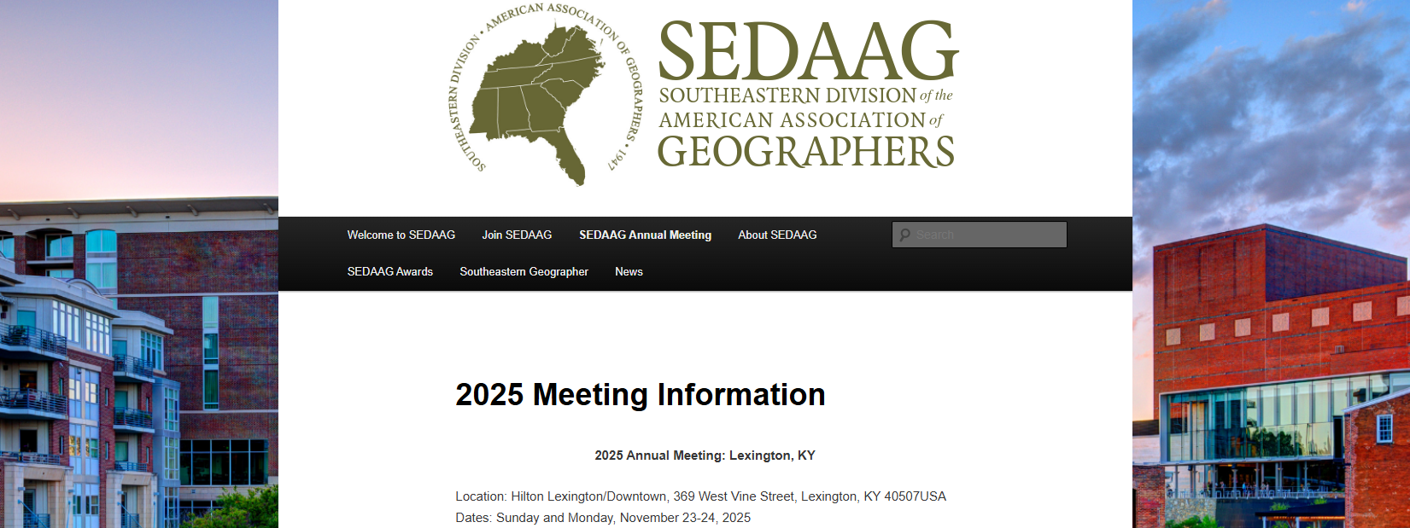
MSU Graduate Student Bears venture to Lexington, KY in November
to present their research

Slide 2
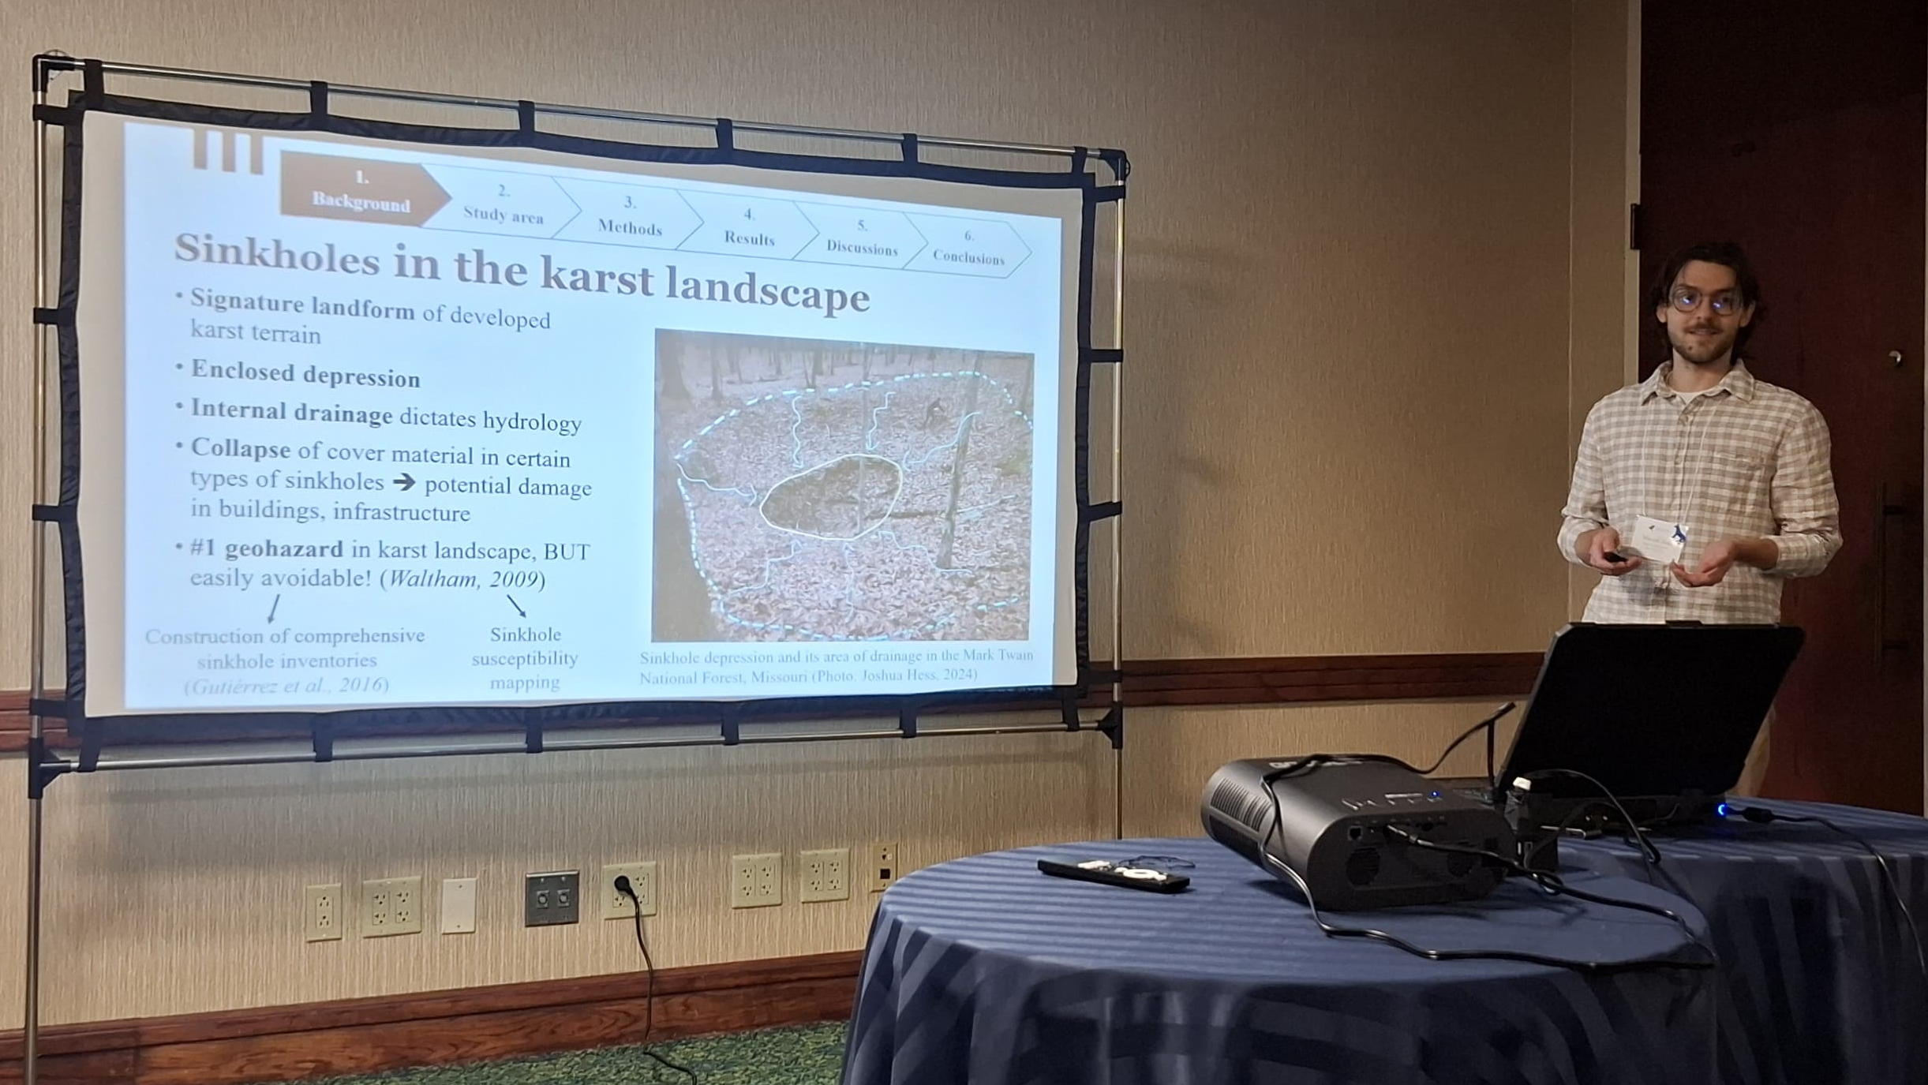
Notes:
Marcell Toth makes a presentation at the SEDAAG Annual Meeting in Lexington, KY

Slide 3
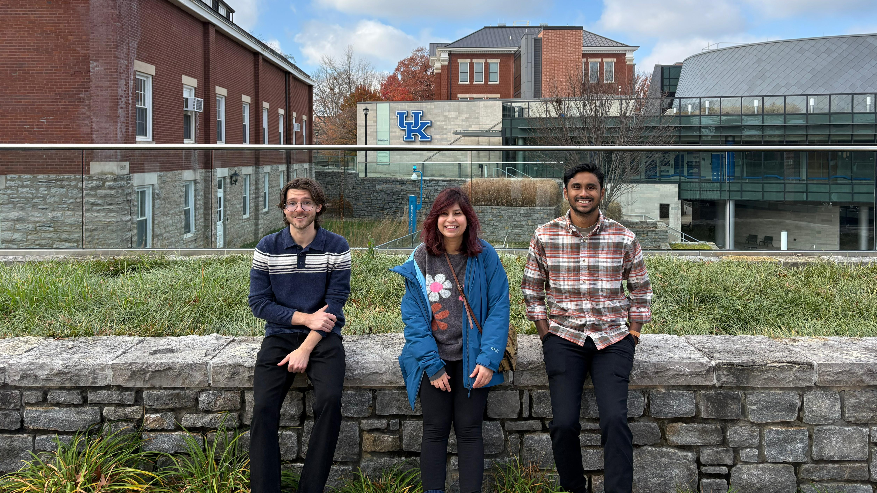
Notes:
Left to right: Marcell Toth, Dr. Tasnuba Jerin, Kaiser Mostafiz, November 2025 at the SEDAAG Annual Meeting in Lexington, KY

Slide 4
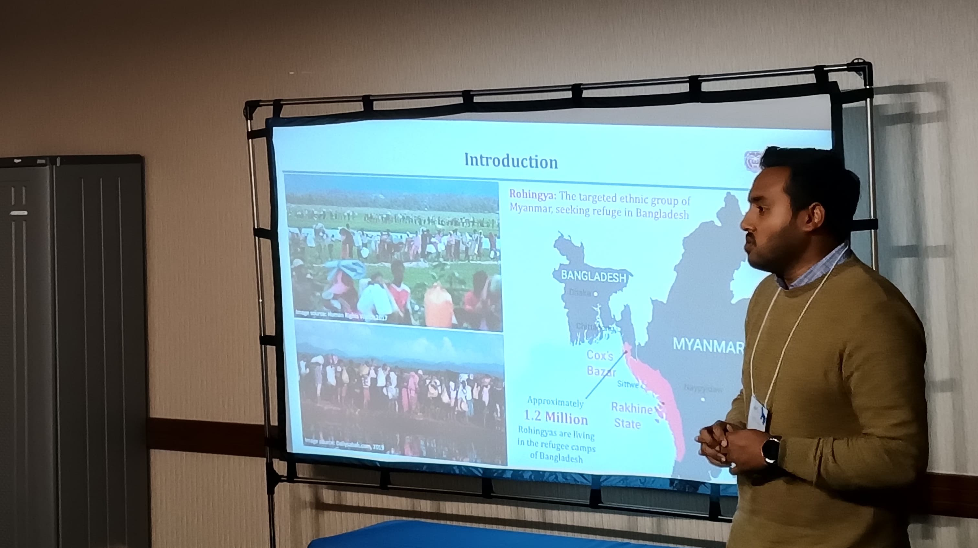
Notes:
MD Iftiaz Rabby making a presentation SEDAAG Annual Meeting, Lexington, KY, November 2025

Slide 5
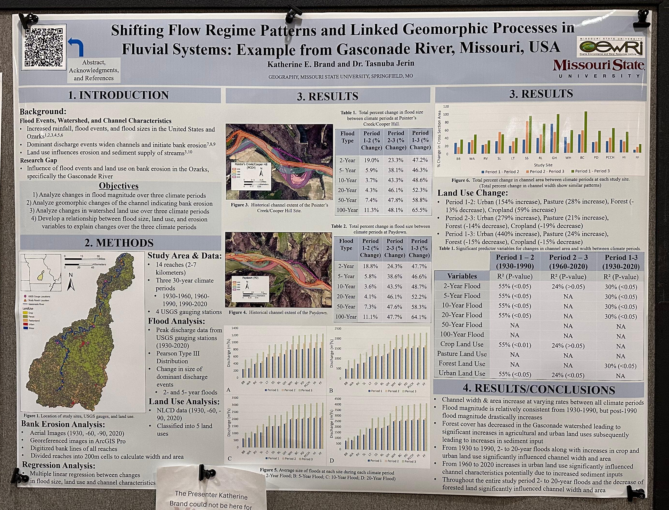
Notes:
Katherine Brand and Dr. Tasnuba Jerin make a presentation at the SEDAAG Annual Meeting, Lexington, KY

Slide 6
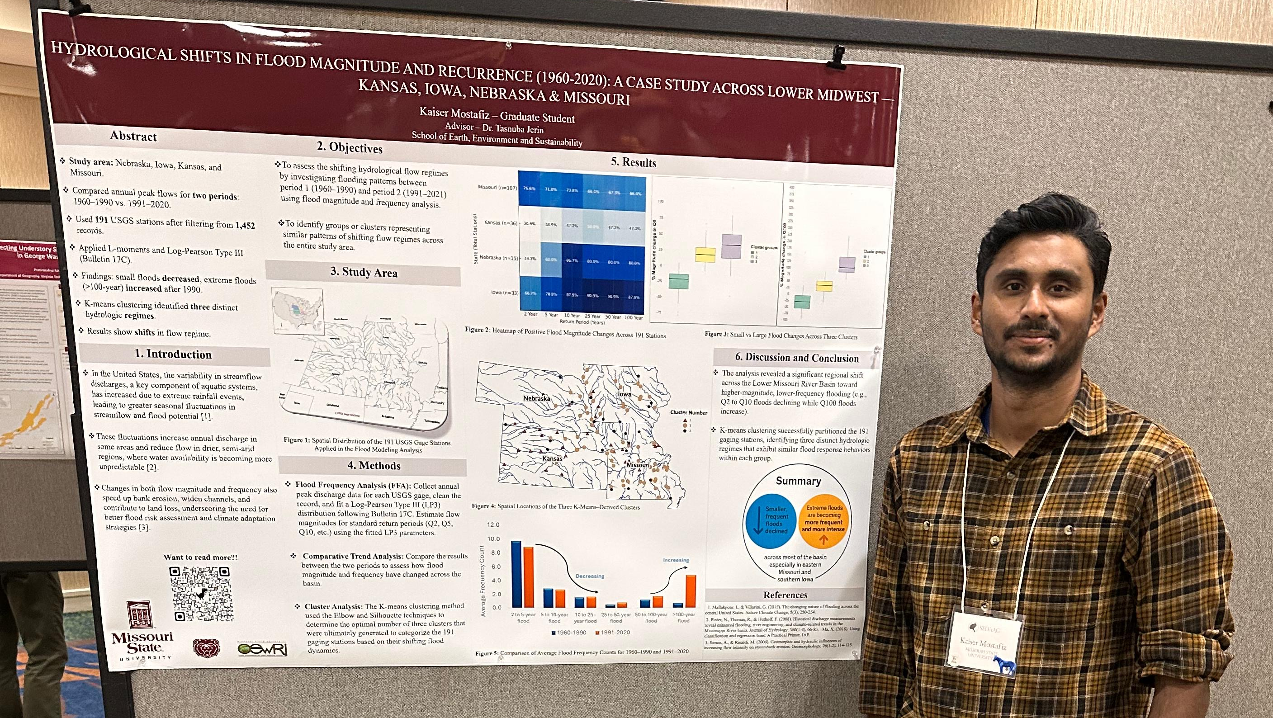
Notes:
Kaiser Mostafiz makes a presentation at the SEDAAG 2025 Annual Meeting in Lexington, KY, November 2025

Slide 7
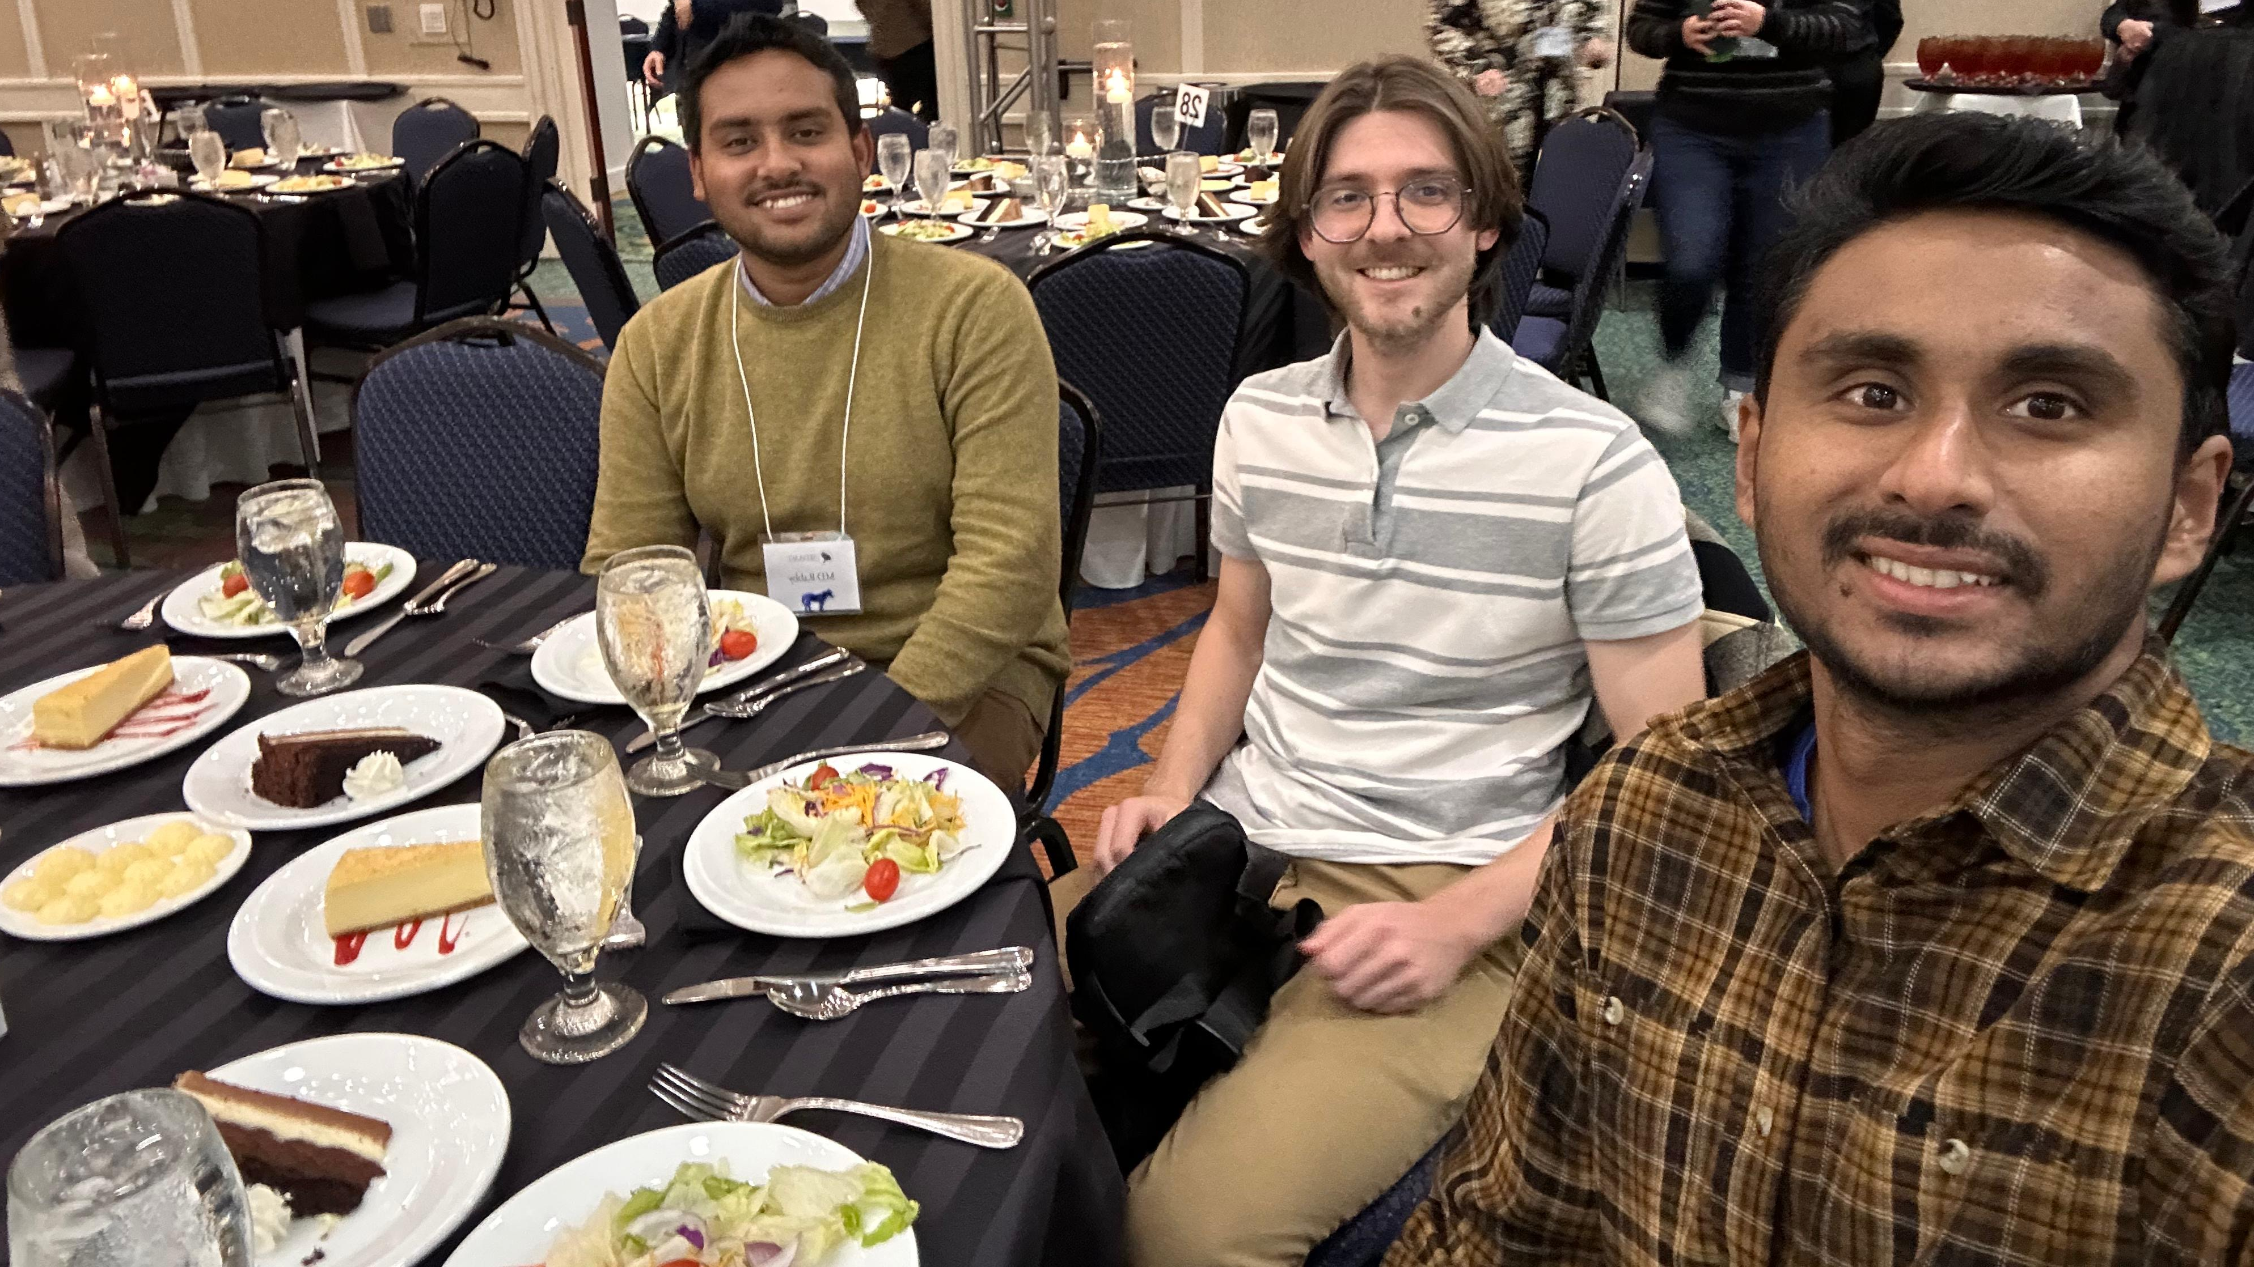
Notes:
Left to Right: ND Iftiaz Rabby, Marcell Toth and Kaiser Mostafiz at the 2025 SEDAAG Annual Meeting in Lexington, KY

